Slide 1
History in Mathematics
Stacey Challen
Assignment 3_ s263297

Slide 2
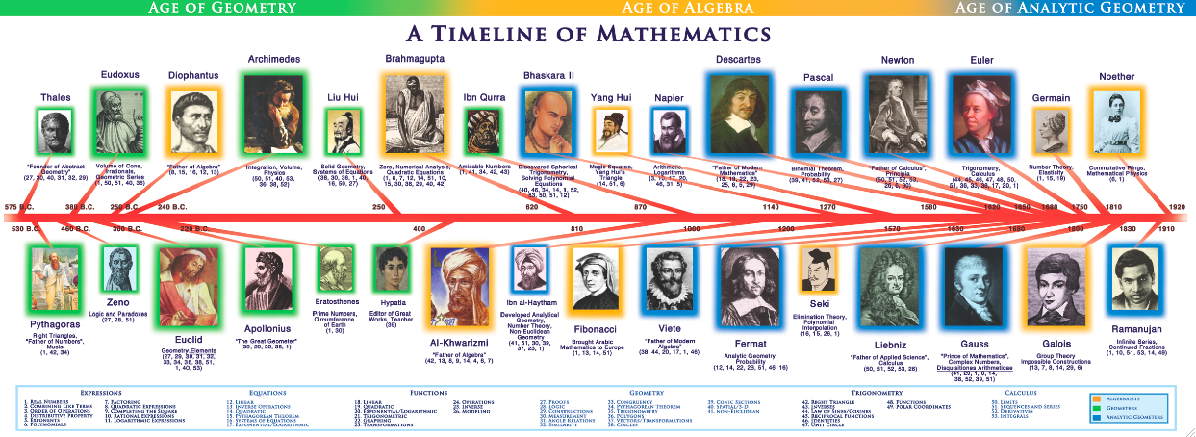
Mathematics in History
As an educator it is important to teach to the students’ cultural strengths and identities to promote student achievement and a sense of well-being within the students’ cultural place in the world. As digital technologies expand and continue to enhance student learning in all areas in preparation for the future, it is important for students to know the history of mathematics. I believe that by allowing students’ to have a mathematical understanding of timelines in history along with time frames and spatial information, it is creating a culturally responsive pedagogy that will enhance students’ confidence to participate in challenging and engaging experiences.
Through this presentation I will explore mathematics throughout history and the developments over time that have shaped mathematical applications we know today. I will offer lesson/ unit plans that enhance student learning along with curriculum outcomes.

Slide 3
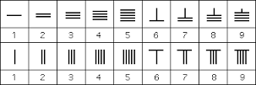
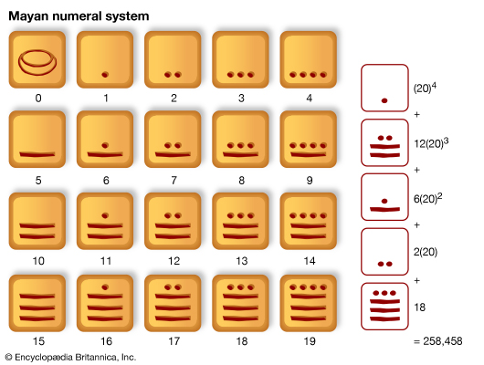
The Origins of Number
The origins of number could be seen on ancient Egyptian tombs. Egyptians used early cave drawings and hieroglyphics to record useful information to pass it on to future generations. These recordings were used to not only give information about how best to live but offered where food sources were available and even included quantities. A famous papyrus found in a grave of a member of the royal establishment that showed mathematical applications through bookwork in the Royal Court of Egypt. This showed income and expenditures as well as receipts and surplus for the court. Over time, it has become apparent of many historical numeric systems. Roman numerals today are often used in the media through descriptions for movies and in the Australian curriculum to recognise similarities and differences between the meanings of signs and symbols in everyday life (ACARA 2017).
Other numeric systems include the Greek system, the early and later Chinese numeric system, the Babylonian and the Mayan numeric system. According to Siemon et al (2011), such numeric systems have evolved overtime, and have assisted in transcending language barriers and many other developments in physics, astronomy and other fields. As an educator, it is important to provide students with the tools to gain meaning and develop the appropriate language to develop their skills in Western mathematics. Through providing experiences for students to gain this meaning is providing them with the tools to not only a culturally inclusive classroom but also a culturally responsive one, which is equally important.

Slide 4
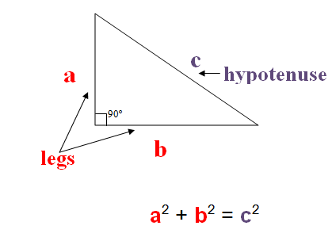
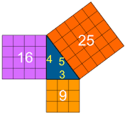
Pythagoras
The Pythagorean theorem is based on a mathematician who is famous for his theorem that relates to an equation relating the lengths of the sides a, b and c, where c represents the length of the hypotenuse and a and b the lengths of the triangle's other two sides (Moledina & Repka 2013). Pythagoras founded a group of scholars who then were named the Pythagoreans and became the name for the theorem. However, it is Pythagoras himself who was credited with it’s first recorded proof. Through the Australian curriculum, students are able to apply Pythagoras’ Theorem by solving right-angled triangle problems. It is important that students understand the importance of recognizing the mathematical knowledge and to build on it.

Slide 5
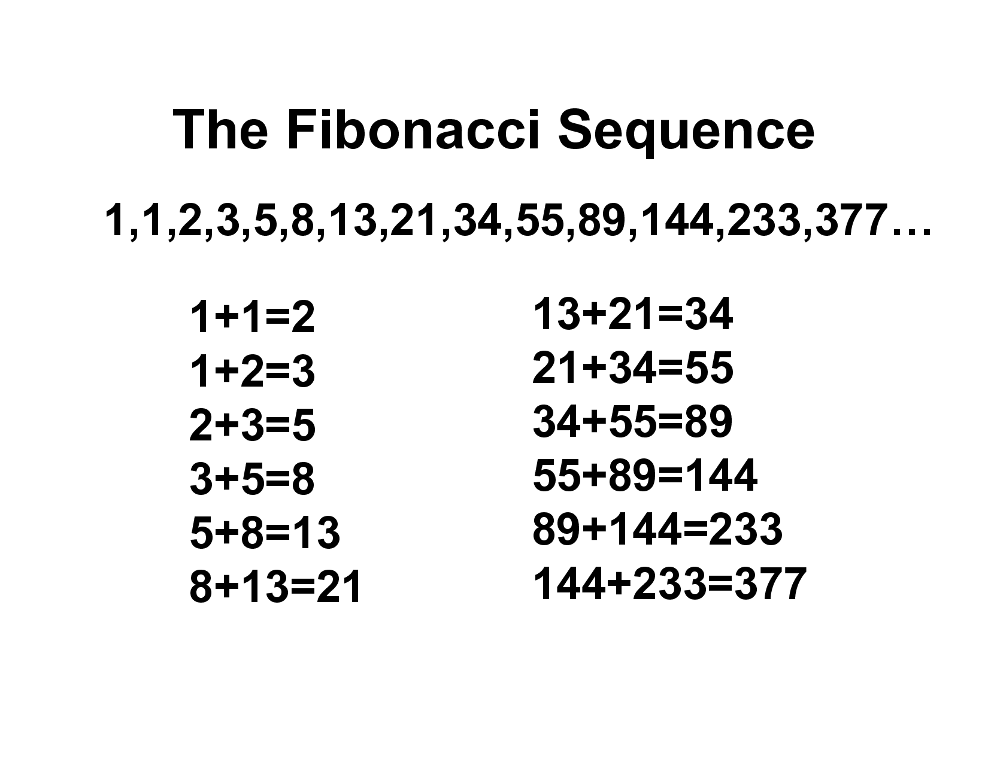
The Fibonacci Sequence
The Fibonacci sequence is named after Leonardo Fibonacci. It is a set of numbers that start with a zero or a one and is then followed by a 1 and each number is then equal to the sum of the previous two numbers. Fibonacci did not find or create the arithmetic behind this famous sequence. However, he was seen as a mathematical genius and realized that by packaging the sequence in a way that the common man could understand and use, he then became well known for the application. This then was seen as a turning point in the history of mathematics as a personal computing revolution.

Slide 6
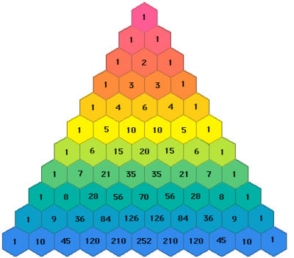
Pascal’s Triangle
A French scientist named Blaise Pascal is now associated with one of the most interesting number patterns even known. Pascal, was the first to write about the properties and applications of the triangle. The rule in the triangle is that each entry in the triangle is the sum of the two numbers above it. It then displays a pattern that is interesting and plays an important role in probability theory, algebra and number theory today (Farina, Giompapa, Graziano, Liburdi, Ravanelli & Zirilli 2013)

Slide 7
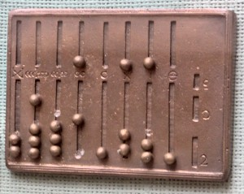
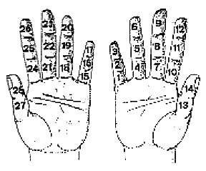
Mathematic Tools and Devices in History
Tools and devices in mathematics have obviously changed throughout history. One of the earliest and most convenient tools used by early humans was their fingers on their hands. Carving notches on sticks and walls were also a method used for numeral applications as well as small objects such as pebbles (Encyclopedia 2017). As previous stated, some early cultures developed some sort of abacus or counting board to perform these calculations. Eventually, pencil and paper replaced such counting boards. However, the abacus in modern form is still used in parts of Russia and Asia. Along with pebbles and sticks, countries in the Western hemisphere used kernels of grain as counters. Place value systems were then introduced and calculations could be recorded.

Slide 8
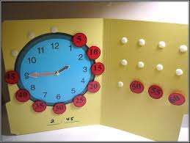
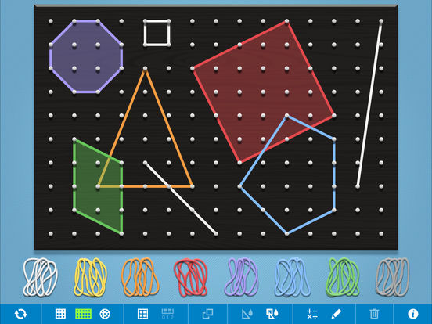
Mathematical Tools and Devices Today
Today, there are many modern teaching aids that can assist students in the application of mathematics. There are even too many devices and tools to mention that have been developed over the years. Dice, clocks, geo boards, money, cards, beads and counters are all used in classrooms today. Along with this advancement in devices for mathematics implementation, digital technology began with the calculator and then has developed these days now accommodate all of these devices either online or through applications. A fantastic lesson plan would be to accumulate for physical touch, old mathematical tools and devices for students to explore. Older students can even research mathematics in history and share with the class their findings on similarities and differences between the tools in history and the tools today.

Slide 9
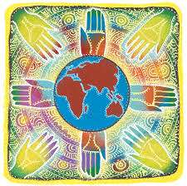
Being Culturally Responsive
In order to construct a culturally responsive pedagogy, I feel it is important to connect students’ knowledge of mathematics in history through their communities. This mathematical knowledge base will assist students in understanding through their cultural connections. As educators, we can use this knowledge base to build mathematical understanding of different applications throughout history. The Australian Curriculum outlines many learning outcomes that encourage the exploration and understanding of culturally diverse students’ backgrounds and traditions.
It is important to make real-life and realistic connections for all students to be able to build on their mathematical knowledge. It is finding these connections through the mathematical applications in history that can help them recognize the importance of the context using the correct language. Pas, Larson, Reinke, Herman & Bradshaw (2016) note how in order for a classroom to be culturally responsive, educators should have some form of school based training or professional development as assistance to improve teacher skills in this area.

Slide 10
The Importance of History in Mathematics
It is important for educators to teach the history of mathematics because it is a part of a common heritage and must not be held from new generations (Heiede 1992). Heiede (1992) also notes how that just like the personal history of every man, woman and family, it is just as important as those individuals today. We now have historians who dig into history and discuss and record their findings with points of views on different individuals and applications. We also have a dedicated area within the Australian Curriculum that deepens students’ understanding and critical thinking to explore mankind’s memories. Through the history of mathematical applications, students’ can use their critical thinking to depict their own opinions about famous mathematicians and philosophers that have shaped the way we apply mathematics today.

